Slide 1
Module1 & Module 2

Slide 2
Data are everywhere.
Most of the projects in several companies every day generate 2.5 quintillion bytes of data.
Not be interpreted in an absolute sense.
The strong need for analytical skills and resources.
As the data piles up, managing and analyzing these data resources in the most optimal way become critical success factors in creating competitive advantage and strategic leverage.

Slide 3
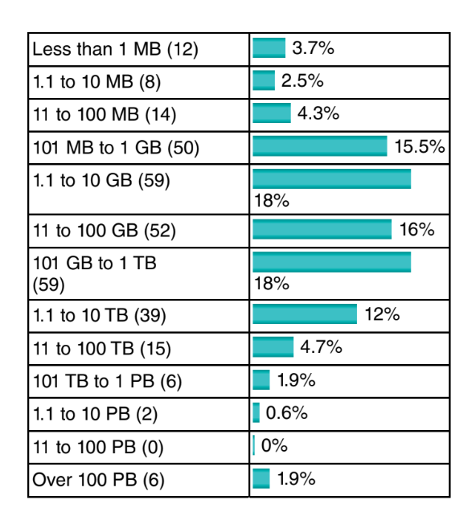
Context of the Poll
Number of Respondents
Categories and Numbers
Median Size of Data
Comparison with Previous Year
Regional Breakdown

Slide 4
Catalogue in the Mail: marketing efforts and increase the likelihood of sales.
Behavioral Scoring Model by Financial Institution:predictive analytics help the bank manage risks and make informed decisions regarding loan provisioning.
Churn Prediction by Telephone Service Provider:customer retention strategies and service improvements.
Social Media Advertising on Facebook: tailor advertisements to your interests
Supermarket Loyalty Card and Market Basket Analysis:supermarket make decisions on product bundling, offers
Credit Card Fraud Detection: prevent fraudulent transactions, protecting both consumers and financial institutions.

Slide 5
Basic Nomenclature:
In order to start doing analytics, some basic vocabulary needs to be defined. The basic unit of analysis.
For Example : Customers can be considered basic unit in several cases like credit scoring exercise,parents can buy goods for their kids, such that there is a clear distinction between the payer and the end user,In a banking setting, a customer can be primary account owner, secondary account owner, main debtor of the credit, codebtor, guarantor, and so on.
In case of predictive analytics, the target variable needs to be appropriately defined.When the customer considered to be a churner or not, a fraudster or not, a responder or not.

Slide 6
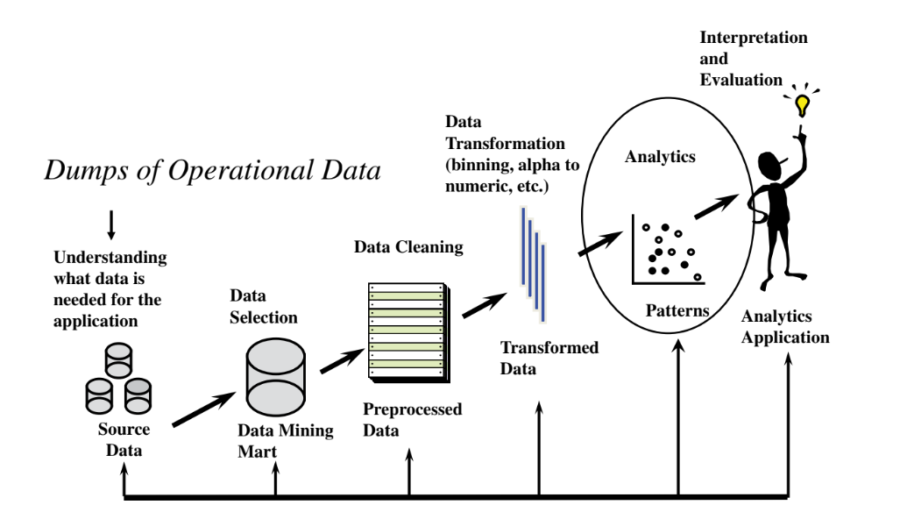
The Analytics Process Model

Slide 7
Data Collection,Sampling, and Preprocessing
Data are key ingredients for any analytical exercise.
It is important to thoroughly consider and list all data sources that are of potential interest before starting the analysis.
TYPES OF DATA SOURCES:
Data can originate from a variety of different sources.
1.Transactions
2.Qualitative, expert‐based data.
3.Publicly available data can be included in the analytical exercise.

Slide 8
1.Transactions
Transactional data are fundamental sources of information in data analysis and are typically structured, detailed records that capture specific actions or events.
Point of Sale Transactions
Online Orders:
Inventory Management Transactions
Customer Service Interactions
Characteristics of Transactional Data: Structured,Detailed,Low-level,
Stored in OLTP Databases.

Slide 9
2. Expertise in Analytics
An expert in analytics is someone who possesses significant subject matter knowledge and experience within a specific domain, such as finance or marketing.
Imagine a credit portfolio manager at a financial institution who oversees the management of loans and credit risk.
Data Evaluation and Expert Input
Modeling and Validation
Model Interpretation and Decision Making

Slide 10
Sampling
The aim of sampling is to take a subset of past customer data and use that to build an analytical model.
Computational Efficiency
Representativeness
Time Window:
Lots of Data
Recent Data

Slide 11
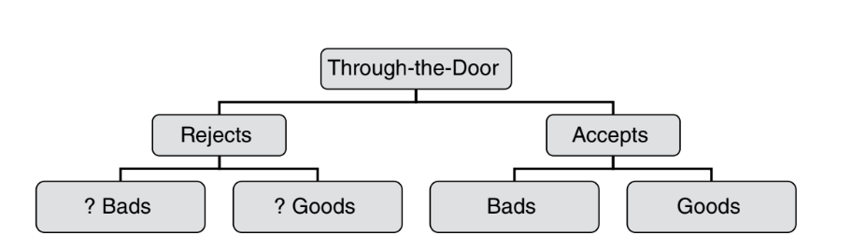
Sampling Bias
Example - Credit Scoring: For instance, when building a credit scorecard for Loan applications, historical data may be biased because rejected applicants (who didn't receive credit) are not included, leading to an incomplete picture.
Reject Inference
Withdrawals

Slide 12
Stratified Sampling
Stratified sampling involves dividing the dataset into pre-defined strata based on certain criteria (e.g., Fraudulent vs. Legitimate).
Illustration : when data is skewed, such as in fraud detection where most cases are non-events (Legitimate), stratified sampling can be employed.
Two classes : Fraud and Legitimate

Slide 13
TYPES OF DATA ELEMENTS
Continuous: income ( Quantitative)
Categorical : (Qualitative)
■ Nominal: marital status, profession, purpose of loan.
■ Ordinal: Include credit rating(Good,fair,Excellent); age(young, middle aged, and old),Feedback(Strongly agree,agree…..).
■ Binary: gender, employment status.
Data Type Selection
Data Handling
Data Collection
For example, if marital status were to be incorrectly specified as a continuous data element, then the software would calculate its mean, standard deviation, and so on, which is obviously meaningless.

Slide 14
VISUAL DATA EXPLORATION AND EXPLORATORY STATISTICAL ANALYSIS
Visual data exploration is a crucial preliminary step in data analysis that involves using graphical representations to gain initial insights into the dataset.
Initial Insights
Pattern Recognition
Data Validation
Types of Visual Tools Used:Pie Charts,Bar Charts,Histograms,Scatter Plots

Slide 15
Next Steps after Visual Analysis:
Analysts typically compute statistical measures such as averages, standard deviations, minimum, maximum, percentiles, and confidence intervals.
These measures help quantify the characteristics of the data and compare distributions between different groups or classes(Fraud or legitimate)(good payer or bad)

Slide 16
Missing values & Handling Missing Values
Missing values in datasets can arise due to various reasons
1.Non applicable Information
2.Undisclosed Information
3.Errors During Data Handling
Handling missing values is essential to ensure accurate and reliable analysis.
1.Imputation: Mean/Median/Regression Models
2.Deletion
3.Keeping Missing as a Separate Category:a customer not disclosing income due to being unemployed

Slide 17
OUTLIER DETECTION AND TREATMENT
Outliers are observations in a dataset that are significantly different from the majority of other data points. They can be classified into two main types:
1.Valid Observations:the salary of a CEO being $1 million per year
2.Invalid Observations:someone's age is recorded as 300 years
Types of Outliers:
1.Univariate Outliers:extremely high or low value in income
2.Multivariate Outliers: someone might have both an exceptionally high income and a very young

Slide 18
Detection of Outliers
1 Histograms: Visualizing the distribution of data to identify unusual patterns or tails in the data distribution.
2. Box Plots (Box-and-Whisker Plots): Showing the distribution of data in quartiles, with outliers indicated as points beyond a certain distance from the quartiles (typically defined as 1.5 times the Interquartile Range, IQR).
3. Z-Scores: Calculating how many standard deviations an observation is away from the mean.
Example: Values with a z-score greater than 3 (or less than -3) are often considered outliers.

Slide 19
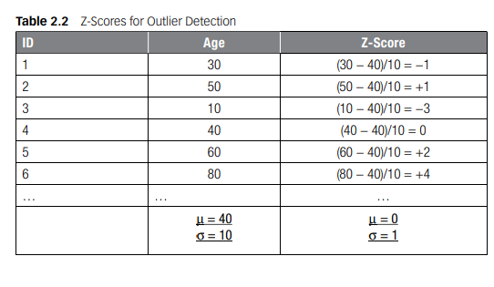

Slide 20
STANDARDIZING DATA
Standardizing data is a crucial preprocessing step in data analysis, particularly when dealing with variables that have different scales or units.
Data standardization helps eliminate redundancies, errors and inconsistencies, resulting in higher data quality. By ensuring data is accurate, clean and consistent, organizations can have confidence in their decision-making process
1. Min/Max Standardization (Normalization):Min/max standardization, also known as normalization, scales the values of a numeric variable to a specific range, typically between 0 and 1.
Xnew​=X−Xmin/ ​Xmax−Xmin​​
where:
X is the original value of the variable,
Xmin​ is the minimum value of the variable,
Xmax​ is the maximum value of the variable.
If income ranges from $0 to $1,000,000, after min/max standardization, the income values will be scaled proportionally between 0 and 1.

Slide 21
2. Z-Score Standardization : Z-score standardization (or normalization) transforms variables to have a mean of 0 and a standard deviation of 1. The formula for z-score standardization is:
Xnew​= X−μ ​/ σ
where:
X is the original value of the variable,
μ is the mean of the variable,
σ is the standard deviation of the variable.
3. Decimal Scaling : Decimal scaling involves dividing the variable by a power of 10 such that the maximum absolute value of the resulting variable is between 0 and 1. The formula for decimal scaling is:
Xnew​=X​ / 10^{n}
where:
X is the original value of the variable,
n is the number of digits of the maximum absolute value of X.

Slide 22
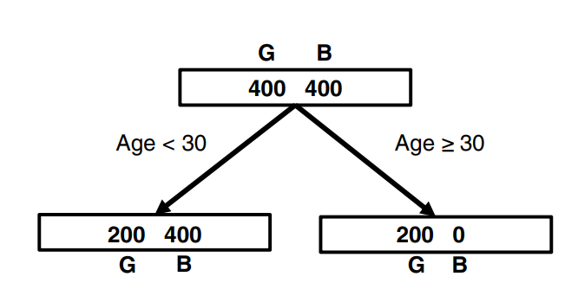
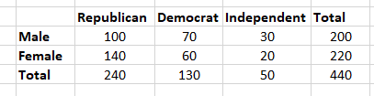
Problems:
Using the runs scored by a cricket team in 12 league matches 100, 120, 110, 150, 110, 140, 130, 170, 120, 220, 140, 110, construct a box plot to visually identify and represent any outliers in the data.
Calculate the Z-scores for the following exam scores: [30, 50, 10, 40, 60, 80], given that the class average score (μ) is 40 and the standard deviation (SD) is 10.
Calculate the entropy for the top node, left node, and right node, and determine the information gain.(Solved in class Refer PPT and textbook)
If gender has anything to do with political party preference. You poll 440 voters in a simple random sample to find out which political party they prefer. The results of the survey are shown in the table below. (Solved in class)

Slide 23
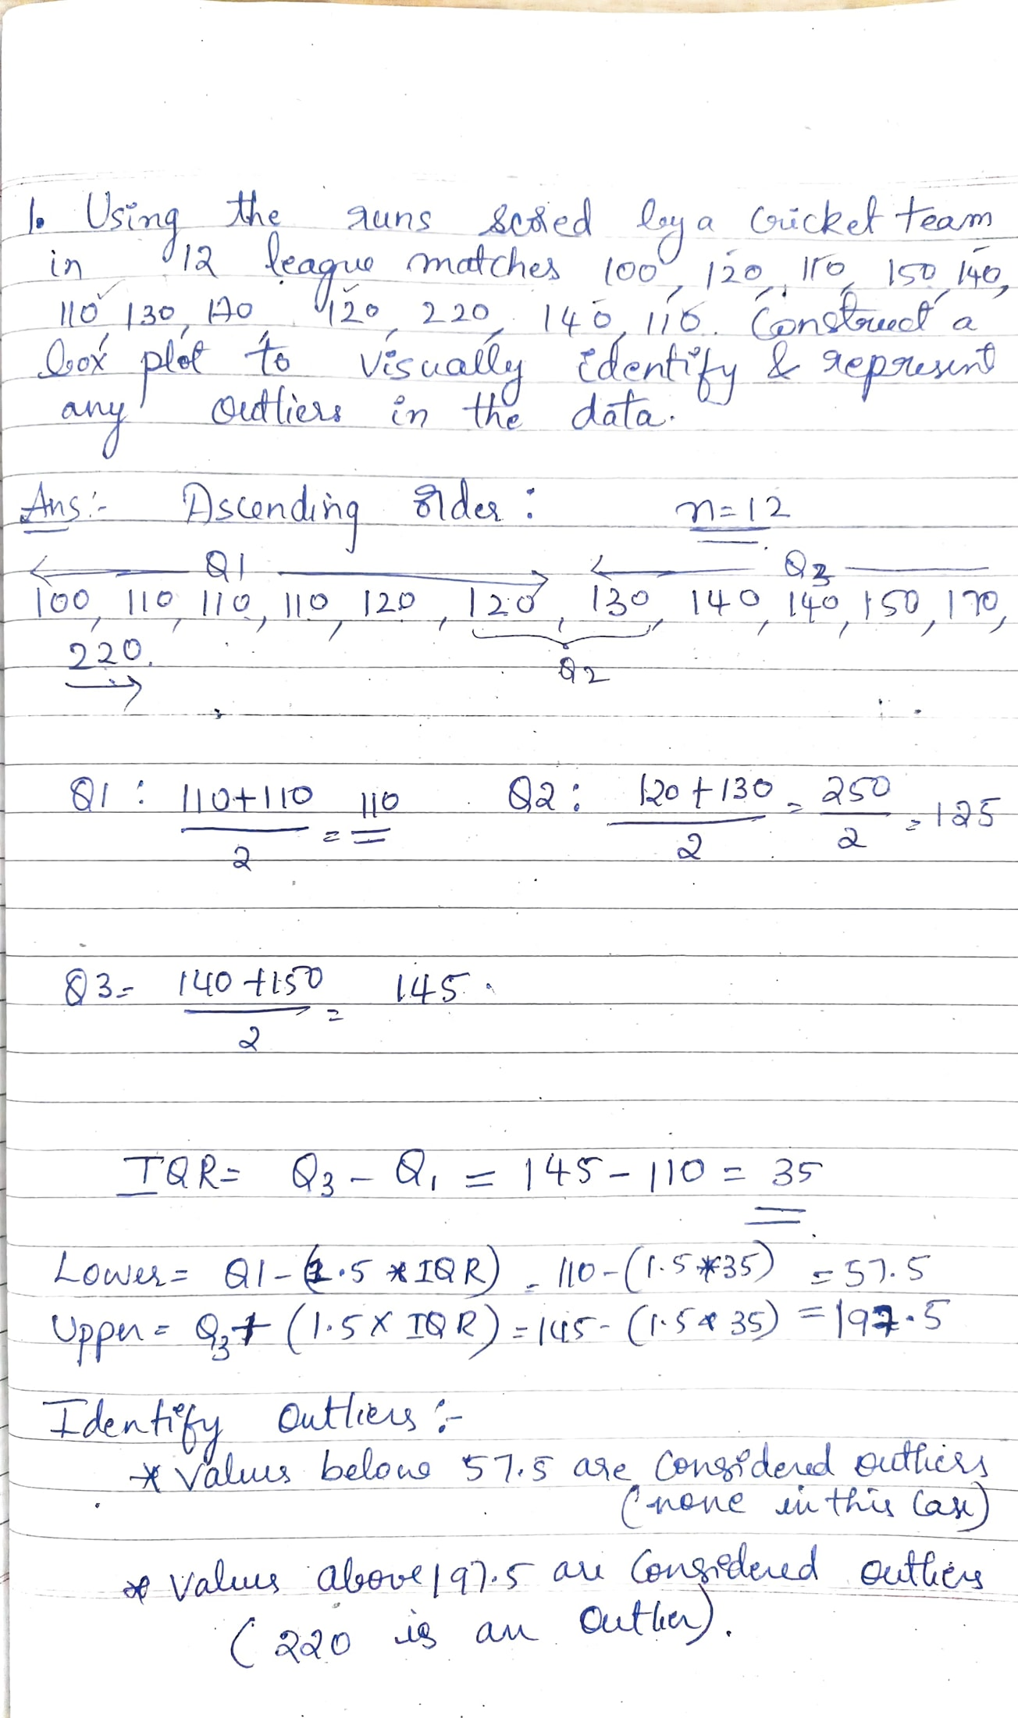
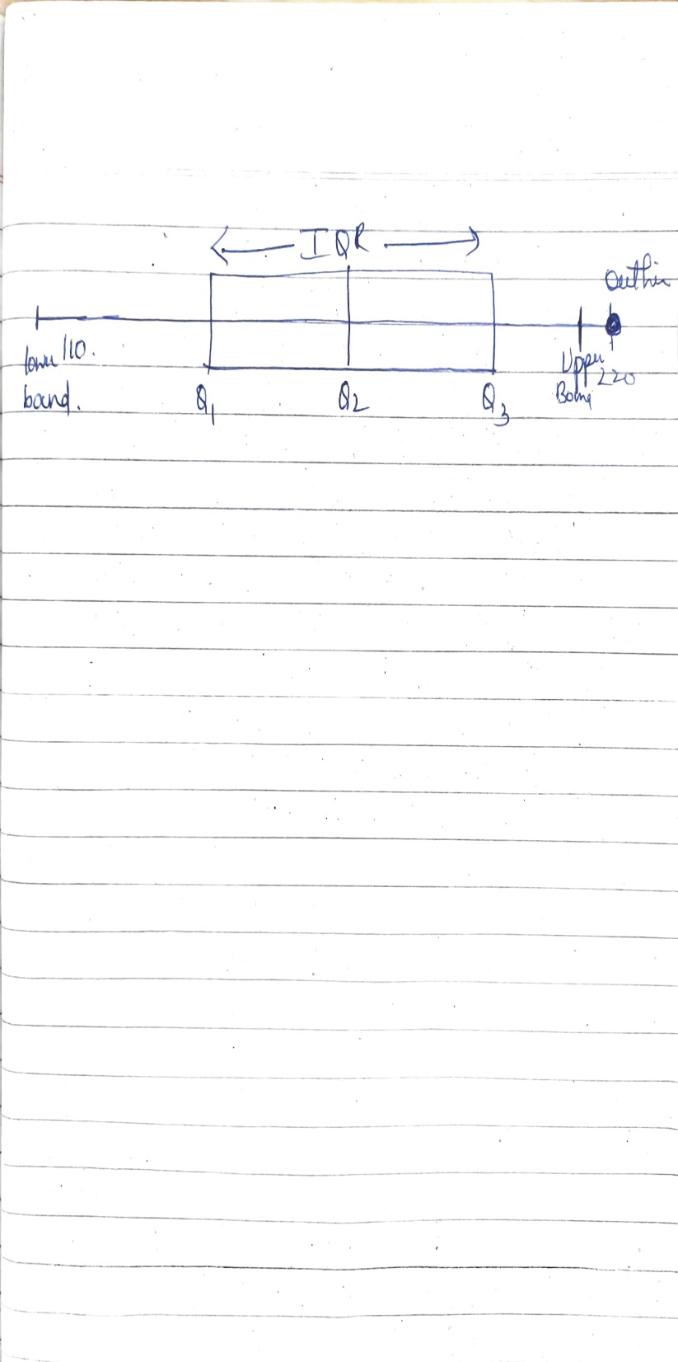
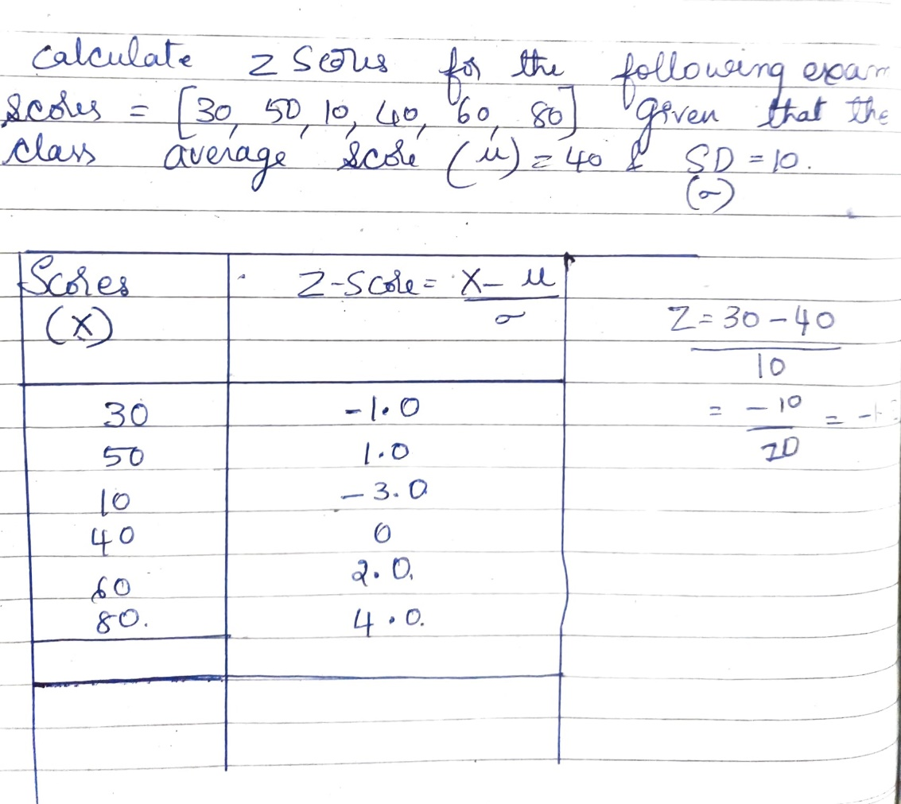

Slide 24
The data provided pertains to different categories of residential status and their associated outcomes categorized as "Good" and "Bad". Here’s a breakdown of the data and the approach to coarse classification: ( Similar as previous problem political party preference. Explained in class refer textbook)
The frequencies for each category under the "Good" and "Bad" outcomes are provided:
Objective:
The objective is to classify the residential status variable into three categories using chi-squared analysis. Two options are considered:
Option 1: Owner, Renters, Others
Option 2: Owner, With Parents, Others
Chi-Squared Analysis
Chi-squared analysis helps determine if there is a significant association between categorical variables. Here, it’s used to evaluate how well the observed frequencies (from the data) match the expected frequencies (if the categories were independent).
Attribute | Owner | Rent Unfurnished | Rent Furnished | With Parents | Other | No Answer | Total
Good | 6,000 | 1,600 | 350 | 950 | 90 | 10 | 9,000
Bad | 300 | 400 | 140 | 100 | 50 | 10 | 1,000

Slide 25
CATEGORIZATION
Categorization = coarse classification, classing, grouping, binning, etc.
Categorization refers to the process of grouping data into discrete categories or bins based on certain criteria.
Example: Rainfall Prediction Dataset
Dataset Description: Imagine we have a dataset that includes information about rainfall in different regions over several years. Each record in the dataset might include:
Region: The geographical area where the rainfall was measured.
Month: The month in which the rainfall data was recorded.
Rainfall Amount: The amount of rainfall measured in millimeters (mm).
Temperature: The temperature recorded during the rainfall event.

Slide 26
Categorization Process
Grouping by Rainfall Amount:
Low Rainfall: 0-50 mm
Moderate Rainfall: 51-100 mm
High Rainfall: >100 mm
Simplify the analysis
Easier to interpret patterns and trends in the data.
2. Grouping by Month:
Spring: March, April, May
Summer: June, July, August
Autumn: September, October, November
Winter: December, January, February
Help identify seasonal patterns in rainfall.
Analyze how rainfall varies across different seasons.

Slide 27
3. Grouping by Temperature Range:
Cool: 0-10°C
Moderate: 11-25°C
Warm: 26-35°C
Hot: >35°C
Understand how temperature influences rainfall patterns and vice versa.
Purposes of Categorization:
Simplifying Analysis
Reducing Complexity
Preparing for Models

Slide 28
For categorical variables, it is needed to reduce the number of categories:
Categorical variables : qualitative data and can take on a finite number of distinct values or categories. For example, "Gender" (Male, Female), "Education Level" (High School, College, Graduate), or "Country" (USA, Canada, UK).
Categorical variables can have a large number of distinct categories. For instance, a variable like "City" could have hundreds or thousands of unique values if each city is considered separately. This can complicate statistical analysis and modeling because each category may not have enough data points for reliable estimation or inference.
To address this complexity, reducing the number of categories by grouping similar values together can be beneficial. This process, known as categorization or grouping, simplifies the dataset by consolidating similar categories into broader groups.
By reducing the number of categories, the dataset becomes more manageable for analysis.

Slide 29
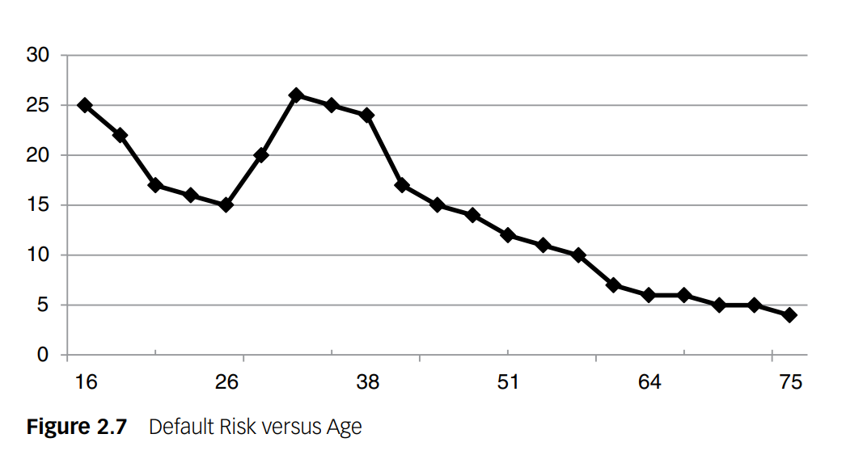
Relation between risk and age are not linear or monotonous.
Nonlinear models such as neural networks or support vector machines can capture complex such relationships. These models are flexible and can fit intricate patterns in data without assuming linearity.
In contrast to nonlinear models, traditional regression models (like linear regression) assume a linear relationship between the predictor (age) and the outcome (risk).
By categorizing the variable into ranges, part of the nonmonotonicity can be taken into account in the regression. Hence, categorization of continuous variables can be useful to model nonlinear effects into linear models.

Slide 30
Various methods can be used to do categorization
Equal interval binning
Equal frequency binning.

Slide 31
Equal interval binning
Equal interval binning involves dividing the range of continuous values into equal-sized intervals or bins. This method is straightforward and ensures that each interval has the same width.
Example: Age Distribution
Suppose we have a dataset of individuals with their ages recorded in years. We want to categorize age into 5 equal intervals using equal interval binning:
Data:
Ages: 18, 22, 25, 30, 35, 40, 45, 50, 55, 60
Equal Interval Bins:
Interval 1: 18-27 years
Interval 2: 28-37 years
Interval 3: 38-47 years
Interval 4: 48-57 years
Interval 5: 58-67 years

Slide 32
Equal frequency binning
Divides the data set into bins that all have the same number of samples.
Input: [5, 10, 11, 13, 15, 35, 50, 55, 72, 92, 204, 215]
Output: [5, 10, 11, 13] [15, 35, 50, 55] [72, 92, 204, 215]

Slide 33
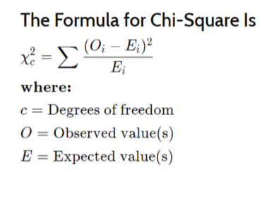
Chi-squared analysis is another method to do categorization.
A chi-square (χ2) statistic is a test that measures how a model compares to actual observed data.
A chi-square test is used to help determine if observed results are in line with expected results, and to rule out that observations are due to chance.
A chi-square test is appropriate for this when the data being analysed is from a random sample,and when the variable in question is a categorical variable.
χ2 provides a way to test how well a sample of data matches the (known or assumed) characteristics of the larger population that the sample is intended to represent. This is known as goodness of fit.

Slide 34
Variable Selection
Variable selection is a crucial step in analytical modeling, especially when dealing with datasets that contain numerous variables.
The goal is to identify and retain only those variables that significantly contribute to predicting the target variable of interest.
In many modeling exercises, datasets may contain a large number of variables, but not all of them are relevant or useful for predicting the outcome (target variable). Including irrelevant variables can lead to overfitting and reduced model performance on new data.
Filters are a type of variable selection method that operate by evaluating the individual relationship between each predictor variable and the target variable.
Mechanism of Filters:
Univariate Correlation Measurement: Filters assess the strength of association between each predictor variable and the target variable independently. Common measures used for this purpose include:
Pearson's correlation coefficient: Measures linear correlation between numeric variables.
Chi-squared test: Assesses association between categorical variables and the target.
Information gain: Measures the reduction in entropy or uncertainty about the target variable given the predictor variable.

Slide 35
TARGET DEFINITION
Understanding the target variable is crucial in any analytical or modeling process because it defines what you are trying to predict or understand.
Customer Attrition (Churn)
Active Churn: Occurs when a customer intentionally terminates their relationship with a company, such as cancelling a contract with a postpaid telecom provider.
Passive Churn: Happens when a customer reduces their engagement with a company without formally terminating it, like decreasing purchase frequency at a supermarket.
Forced Churn: Initiates when a company discontinues its relationship with a customer due to reasons like fraud.
Expected Churn: Occurs when a customer no longer needs a product or service, such as buying baby products.

Slide 36
Fraud Detection:
Identifying fraudulent transactions or claims is challenging, typically requiring expert judgment or suspicion based on legal criteria.
Response Modeling:
Gross Response: Represents customers who make a purchase after receiving a marketing message.
Net Response: Focuses on customers who purchase specifically because of the marketing message

Slide 37
Customer Lifetime Value (CLV) is a metric that represents the total revenue a business expects to earn from a customer over the entirety of their relationship. It takes into account both direct and indirect revenue generated from the customer, deducting the costs associated with serving that customer, and considers the probability of the customer remaining active over a specified time horizon.
Continuous Target: Represents the total value a customer is expected to bring over their entire relationship with a business, factoring in revenue, costs, survival probability, and discounting over a specified time horizon.

Slide 38
Importance of Defining the Target
Clarity: Ensures everyone understands what the analysis aims to predict or understand.
Relevance: Focuses efforts on variables and models that directly impact the target variable.
Consistency: Allows for meaningful comparisons and evaluations over time.
Before proceeding with modeling, it's crucial to validate the chosen target definition for robustness and stability.

Slide 39
Linear Regression
Linear regression is a fundamental statistical method used for modeling the relationship between a dependent variable (often denoted as Y) and one or more independent variables (denoted as X1,X2,…, Xp​).
Dependent Variables = target or response variable
Independent variables = predictors or features
It assumes a linear relationship between the predictors and the response variable.

Slide 40
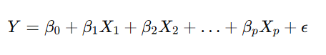
Model Representation
The linear regression model can be represented as:
Y is the dependent variable (target or response variable).
X1,X2,…,Xp ​ are independent variables (predictors or features).
β0,β1,…,βp​ are coefficients that represent the relationship between the independent variables and the dependent variable.
ϵ is the error term which represents the variability in Y that cannot be explained by the linear relationship with X.

Slide 41
Parameter Estimation
Linear regression estimates the coefficients β0,β1,…,βp​ using methods such as Ordinary Least Squares (OLS).
OLS finds the values of β that minimize the sum of squared differences between the observed values of Y and the values predicted by the linear model.

Slide 42
Interpreting Coefficients
β0​ (intercept): The value of Y when all X variables are zero.
βj (slope coefficients for Xj): The change in Y for a one-unit change in Xj​, holding other variables constant.

Slide 43
Evaluation
R-squared ( R2 ): Measures the proportion of the variance in the dependent variable that is predictable from the independent variables.
Standard Error: Measures the average distance between the data points and the fitted line in the model.
P-values and Confidence Intervals: Indicate the statistical significance of the coefficients βj, helping determine which predictors are important in explaining Y.

Slide 44
LOGISTIC REGRESSION
Linear Regression for Classification Issues:
Error Distribution: Linear regression assumes that the errors (residuals) are normally distributed. In classification tasks, especially when dealing with binary outcomes (e.g., yes/no, 0/1), the response variable Y typically follows a Bernoulli distribution (or binomial distribution for multi-class problems). This means the response variable Y can only take on values of 0 or 1, which does not align with the continuous nature assumed by linear regression.
Interpretation of Predictions :Linear regression predicts continuous values, which are not naturally interpretable as probabilities, particularly because these values can fall outside the [0, 1] range. In classification, we often want predictions that can be directly interpreted as probabilities of belonging to a class.

Slide 45
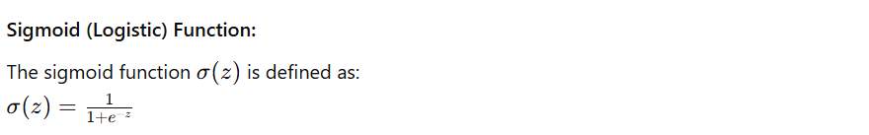
Logistic Regression Transformation:
Logistic regression is often used in classification tasks.
Logistic regression transforms the output of a linear regression model using a sigmoid function (also known as the logistic function), which ensures that the predicted values are bounded between 0 and 1, suitable for interpreting as probabilities.
Where:
z is the linear combination of predictors and coefficients from the linear regression model.

Slide 46
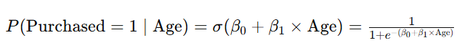

Example :
Linear Regression Prediction : $\hat{Y}$= $β_{0}+β_{1}∗Age$
$\hat{Y}$=0.8 ( which is neither 0 nor 1) (not tell us about probability )
In contrast, logistic regression transforms the output of the linear model using the sigmoid function σ(z):
if P(Purchased=1|Age=30)=0.8 (80% probability that customer aged 30 will purchase the product)

Slide 47

Logistic Regression Model
The logistic regression model transforms the linear regression prediction z into a probability:
P(Y=1∣X) using the sigmoid function:
P(Y=1∣age, income, gender)=$β_{0}+β_{1}$​age+$β_{2}$​income+$β_{3}$​gender)
Here:
$β_{0},β_{1}$, $β_{2}$, $β_{3}$are the coefficients estimated by logistic regression.
age, income, gender are the predictor variables.

Slide 48
Advantages of Logistic Regression
Probability Interpretation
Bounded Outputs
Logistic regression addresses the shortcomings of using linear regression for classification by transforming the linear prediction into a probability using the sigmoid function.
This transformation ensures that predictions are bounded between 0 and 1, allowing for straightforward interpretation as probabilities, which is essential in classification tasks where the goal is often to predict binary outcomes.

Slide 49
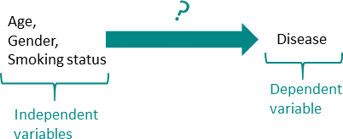
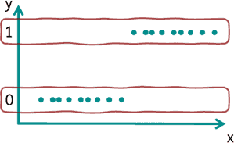
In medicine, for example, a frequent application is to find out which variables have an influence on a disease. In this case, 0 could stand for not diseased and 1 for diseased. Subsequently, the influence of age, gender and smoking status (smoker or not) on this particular disease could be examined.
In the basic form of logistic regression, dichotomous variables (0 or 1) can be predicted. For this purpose, the probability of the occurrence of value 1 (=characteristic present) is estimated.

Slide 50
In linear regression, the independent variables (e.g., age and gender) are used to estimate the specific value of the dependent variable (e.g., body weight).
In logistic regression, on the other hand, the dependent variable is dichotomous (0 or 1) and the probability that expression 1 occurs is estimated.
Example: How likely is it that the disease is present if the person under consideration has a certain age, gender and smoking status.

Slide 51
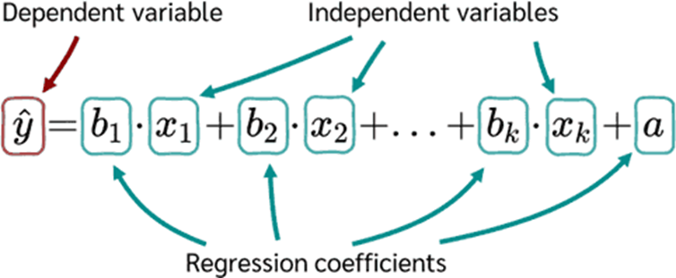
To build a logistic regression model, the linear regression equation is used as the starting point.

Slide 52
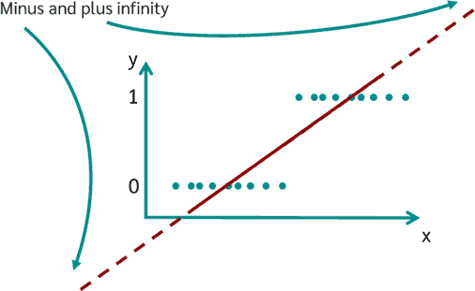
If a linear regression were simply calculated for solving a logistic regression, the following result would appear graphically:
Values between plus and minus infinity can now occur.
The goal of logistic regression, however, is to estimate the probability of occurrence and not the value of the variable itself. Therefore, the this equation must still be transformed.

Slide 53
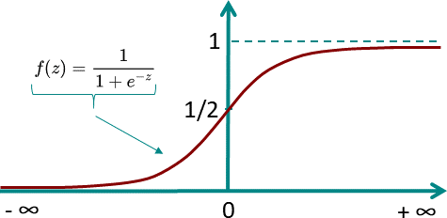
Logistic Function/Sigmoid Function
The logistic model is based on the logical function. The special thing about the logistic function is that for values between minus and plus infinity, it always assumes only values between 0 and 1.
So the logistic function is perfect to describe the probability P(y=1).

Slide 54
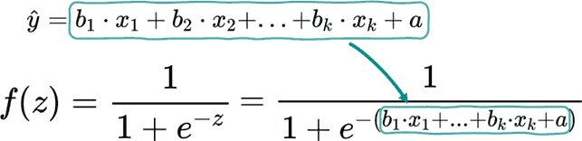
If the logistic function is now applied to the previous regression equation the result is:

Slide 55
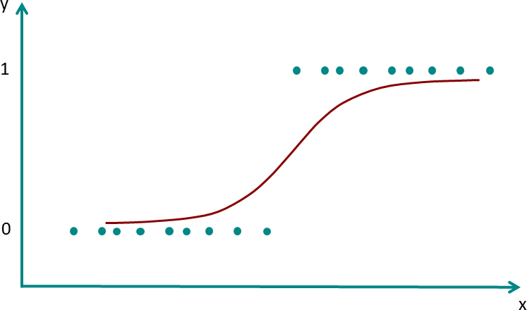
This now ensures that no matter in which range the x values are located, only values between 0 and 1 will come out.
The new graph now looks like this:

Slide 56
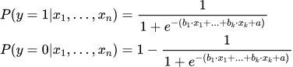
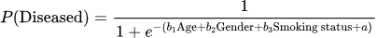
The probability that for given values of the independent variable the dichotomous dependent variable y is 0 or 1 is given by:
To calculate the probability of a person being sick or not using the logistic regression for the example the model parameters b1, b2, b3 and a must first be determined. Once these have been determined, the equation for the example above is:

Slide 57
Maximum Likelihood Method
To determine the model parameters for the logistic regression equation, the Maximum Likelihood Method is applied.
The maximum likelihood method is one of several methods used in statistics to estimate the parameters of a mathematical model.
Another well-known estimator is the least squares method, which is used in linear regression.

Slide 58
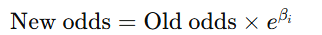
Linear Decision Boundary :
Logistic regression models the log odds (logit) of the binary outcome as a linear combination of the input variables:
Odds Ratio Interpretation:
To interpret the logistic regression coefficients:
Suppose a variable Xi increases by one unit while keeping all other variables constant. The change in the logit can be represented as: New logit=Old logit+βi​
The corresponding change in the odds is:
Here, eβi is the odds ratio, which represents how much the odds of the outcome increase (or decrease) when Xi​ increases by 1 unit:
If βi>0, then eβi>1: The odds and probability of the outcome increase with Xi.
If βi<0, then eβi<1: The odds and probability of the outcome decrease with Xi​.

Slide 59
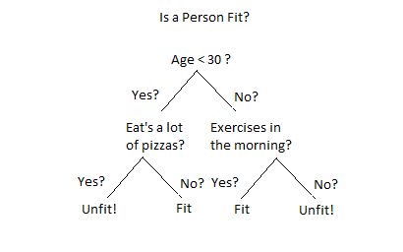
Decision Tree
Decision trees are recursive partitioning algorithms (RPAs) that come up with a tree-like structure representing patterns in an underlying data set. They are popular in machine learning for both classification and regression tasks.
The decision tree consists of several components:
Root Node: The top node representing the
initial testing condition.
Internal Nodes: Nodes representing testing
conditions with outcomes leading to more nodes.
Leaf Nodes: Terminal nodes that provide the
final classification or prediction.

Slide 60
Key Decisions in Building a Decision Tree
Splitting Decision: Determines which variable to split and at what value (e.g., age < 30). This involves minimizing impurity or chaos in the dataset.
Stopping Decision: Determines when to stop growing the tree to avoid overfitting. Overfitting occurs when the tree becomes too specific to the training data, leading to poor generalization to new data. To prevent this, the data is split into a training set and a validation set. The tree growth is stopped based on performance metrics like misclassification error or other criteria.
Assignment Decision: Determines what class or value to assign to a leaf node. e.g., good or bad customer.

Slide 61
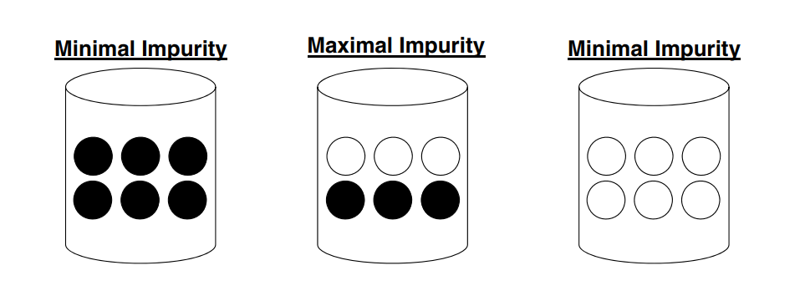
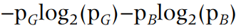
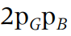
The three data sets below each of which contains good (unfilled circles) and bad (filled circles) customers.
Decision trees will now aim at minimizing the impurity in the data.
In order to do so appropriately, one needs a measure to quantify impurity. There are various measures.
Entropy: E(S) =
Gini: Gini(S) =
Chi‐squared analysis

Slide 62
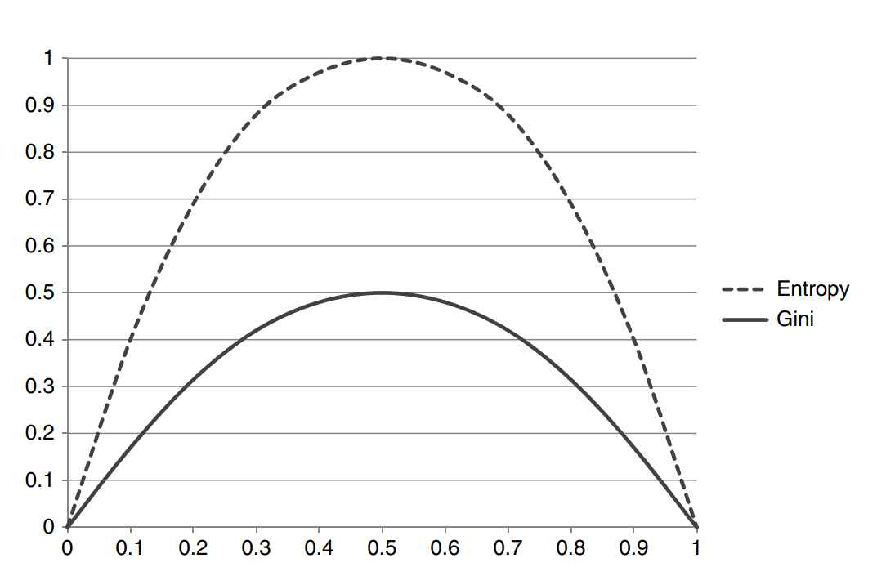
Which is more efficient among the methods then Gini Impurity and entropy in terms of computing power?
For entropy, it first increases up to 1 and then starts decreasing, but in the case of Gini impurity it only goes up to 0.5 and then it starts decreasing.
It requires less computational power. The range of Entropy lies in between 0 to 1 and the range of Gini Impurity lies between 0 to 0.5.

Slide 63
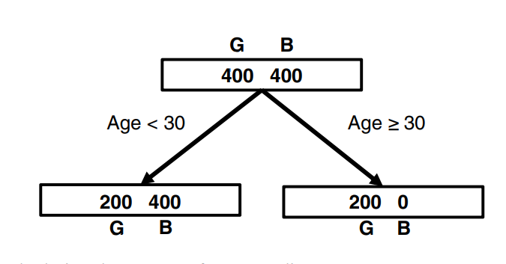
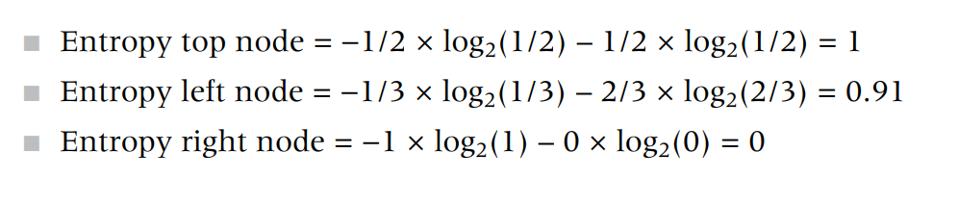
Calculating the Entropy for Age Split

Slide 64
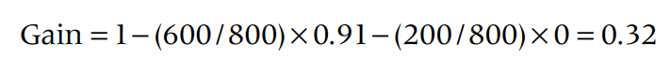
The decision tree algorithm will now consider different candidate splits for its root node and adopt a greedy strategy by picking the one with the biggest gain.
Once the root node has been decided on, the procedure continues in a recursive way to continue tree growing.
When an attribute has an information gain of 0.32, it suggests that using this attribute reduces the uncertainty about the class labels in the data by 0.32 bits on average. Higher information gain indicates that the attribute is more important for classifying the data.

Slide 65
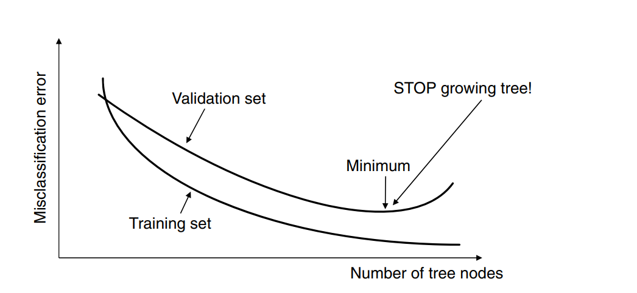
The error on the training sample keeps on decreasing as the splits become more and more specific toward it.
On the validation sample, the error will initially decrease, but at some point it will increase back again since the splits become too specific for the training sample as the tree starts to memorize it. Where the validation set curve reaches its minimum, the procedure should be stopped or overfitting will occur.

Slide 66
Every node had only two branches.
The advantage of this is that the testing condition can be implemented as a simple yes/no question.
Multiway splits allow for more than two branches and can provide trees that are wider but less deep.
In a read once decision tree, a particular attribute can be used only once in a certain tree path.
Every tree can also be represented as a rule set since every path from a root node to a leaf node makes up a simple if/then rule.
These rules can then be easily implemented in all kinds of software packages (e.g., Microsoft Excel).

Slide 67
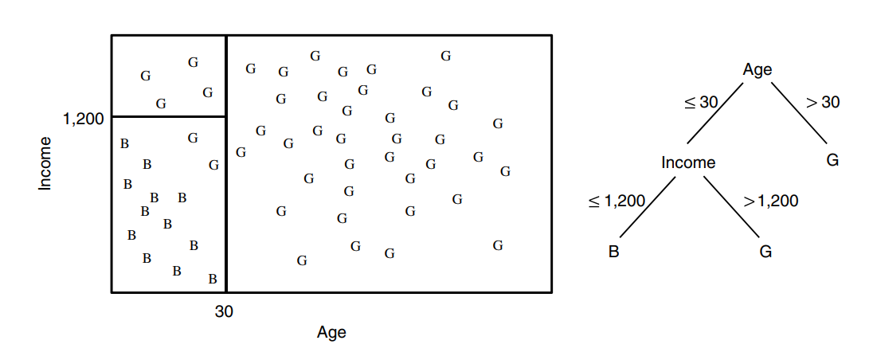
Decision trees essentially model decision boundaries orthogonal to the axes.
Decision Boundary of a Decision Tree

Slide 68
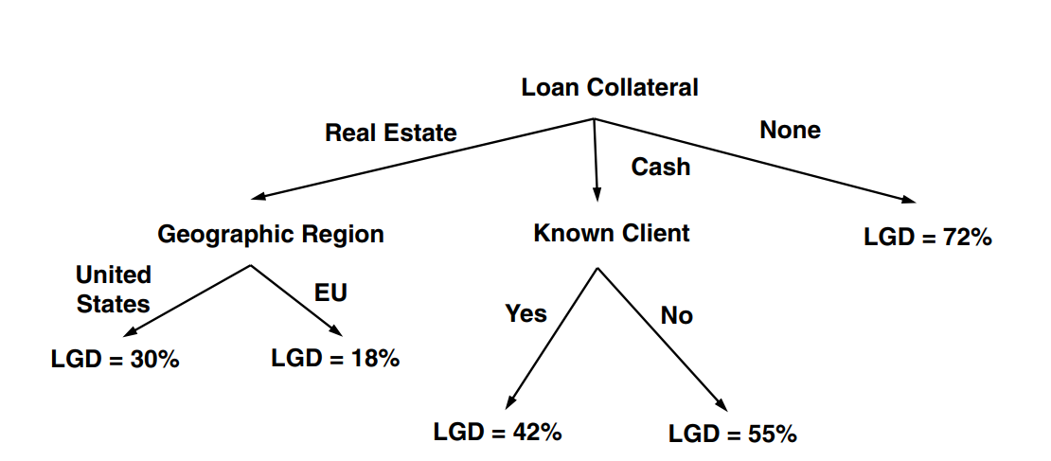
Decision trees can also be used for continuous targets. Example Regression Tree for Predicting LGD(Loss Given Default)

Slide 69
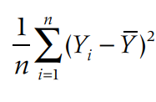
Different way to measure the impurity of the node in a decision tree are :
1. Mean Squared Error(MSE):
where
n = the number of observations in a leave node
Yi = the value of observation i
Y = the average of all values in the leaf node

Slide 70
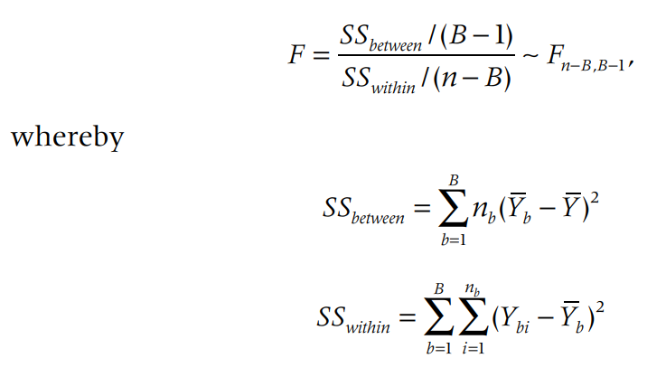
2. ANOVA(Analysis of Variance) Test and calculate F-Statistic:
B : the number of branches of the split
nb : the number of observations in branch b
Yb : the average in branch b
Ybi : the value of observation i in branch b
Y : the overall average
Good splits will then result in a high F value, or low corresponding p‐value.

Slide 71
Neural Network
Neural networks are computational models inspired by how the human brain works, but they are also closely related to existing statistical models.
Two Perspectives
Mathematical Representation Inspired by the Brain:
Neural networks can be seen as mathematical models that are loosely inspired by how the human brain works. This perspective focuses on mimicking the brain's neural structure to solve problems like pattern recognition, classification, and prediction.
Generalizations of Statistical Models:
Alternatively, neural networks can be viewed as extensions or generalizations of traditional statistical models. For instance, logistic regression can be understood as a special case of a neural network.

Slide 72
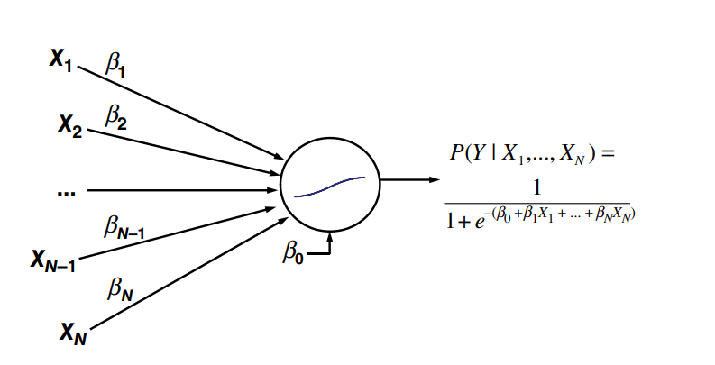
In a neural network view, this model can be seen as a network with a single neuron. The neuron performs two operations:
Weighted Sum: Computes a weighted sum of the inputs (including the bias term).
Nonlinear Transformation: Applies a logistic (sigmoid) function to the weighted sum. This transformation squashes the output to be between 0 and 1, which is ideal for binary classification.
Neural Network Representation of Logistic Regression
The processing element or neuron in the middle basically performs two operations:
It takes the inputs and multiplies them with the weights (including the intercept term β0, which is called the bias term in neural networks) then puts this into a nonlinear transformation function.
Logistic regression is a neural network with one neuron.

Slide 73
Multilayer Perceptron (MLP):
An MLP consists of multiple layers:
Input Layer: Receives the input features.
Hidden Layers: Intermediate layers that apply nonlinear transformations to the inputs.
Output Layer: Produces the final prediction.

Slide 74
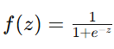
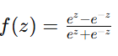
Activation Functions:
Different activation functions determine how the neurons transform their inputs:
Logistic Function (Sigmoid): ranges from 0 to 1, often used for classification tasks.
Hyperbolic Tangent (tanh): ranges from -1 to 1, frequently used in hidden layers.
Linear Function: f(z)=z is used for regression tasks where the output is a continuous range.

Slide 75
Universal Approximation Theorem
One Hidden Layer:
Theoretically, a neural network with just one hidden layer can approximate any continuous function to a desired accuracy, given enough neurons. This property is known as the Universal Approximation Theorem.
More Hidden Layers:
For more complex patterns or functions, such as those involving discontinuities, additional hidden layers might be needed. However, in practice, many real-life datasets do not require this complexity.

Slide 76
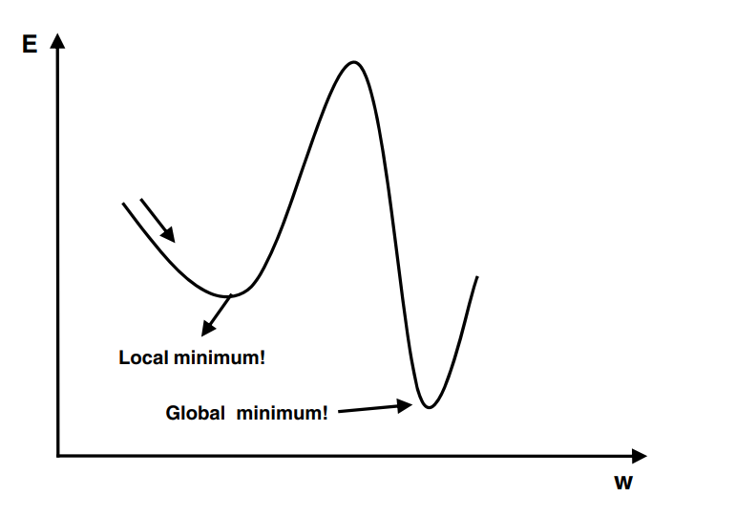
The point at which a function takes the minimum value is called global minima.
However, when the goal is to minimize the function and solved using optimization algorithms such as gradient descent, it may so happen that function may appear to have a minimum value at different points.
Those several points which appear to be minima but are not the point where the function actually takes the minimum value are called local minima.
Machine learning algorithms such as gradient descent algorithms may get stuck in local minima during the training of the models.

Slide 77
Error Function and Minima
Error Function (or Cost Function):
The error function measures how well the neural network’s predictions match the actual values. It’s a key part of the training process, and the goal is to minimize this function.
Local Minima vs. Global Minimum:
Global Minimum: The absolute lowest point of the error function. This is where the model performs the best, achieving the lowest possible error.
Local Minima: Points where the error function is lower than its immediate surroundings but not necessarily the lowest point overall. These are suboptimal solutions where the algorithm might get stuck.

Slide 78
Challenges with Local Minima
Multiple Local Minima:
The error function in neural networks can be complex with many local minima due to the non-linear nature of the network. This makes it challenging to find the global minimum.
Getting Stuck:
If the initial weights are poorly chosen, the optimization process might converge to a local minimum rather than the global minimum. This means the network might not perform as well as it could.

Slide 79
Strategies to Avoid Local Minima
Multiple Starting Points:
Trying Different Starting Weights: By initializing the network with different sets of starting weights and running the optimization multiple times, you increase the chances of finding a better (lower error) solution. This approach helps explore different regions of the error function landscape.
Best Intermediate Solution:
Early Stopping and Best Solution: Start the optimization with different weight initializations, and after some steps, save the best solution encountered so far. This way, you can continue training from the best intermediate solution rather than from a potentially worse initial setup.

Slide 80
Optimization Procedure
Iterative Process:
Epochs: An epoch refers to one complete pass through the entire training dataset. The optimization process involves running multiple epochs, adjusting weights based on the error function after each pass.
Stopping Criteria:
Error Function Progress: Continue the optimization until the error function no longer shows significant improvement, indicating that the network has converged to a minimum.
Weight Changes: Stop when the weights stop changing substantially, suggesting that further training might not yield better results.
Fixed Number of Steps: Alternatively, you can set a fixed number of optimization steps (epochs) to control the training duration, balancing between computational cost and model performance.

Slide 81
Neural networks are described as black boxes because their internal workings are complex and opaque. The relationships between inputs and outputs are not easily understandable due to the non-linear and multi-layered transformations involved. Two ways to open up the neural network black box are rule extraction and two‐stage models.
Decompositional rule extraction approaches decompose the network’s internal workings by inspecting weights and/or activation values. A typical five‐step approach here could be:
Train a neural network and prune it as much as possible in terms of connections.
Categorize the hidden unit activation values using clustering.
Extract rules that describe the network outputs in terms of the categorized hidden unit activation values.
Extract rules that describe the categorized hidden unit activation values in terms of the network inputs.
Merge the rules obtained in steps 3 and 4 to directly relate the inputs to the outputs.

Slide 82
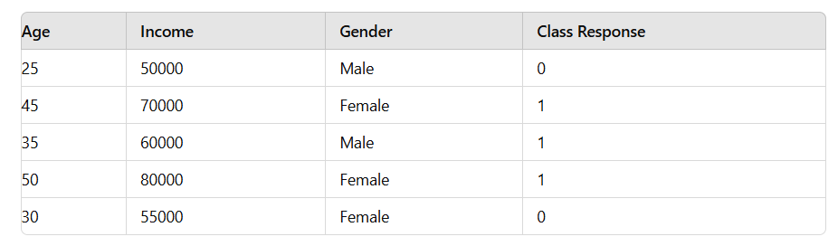
Example:

Slide 83
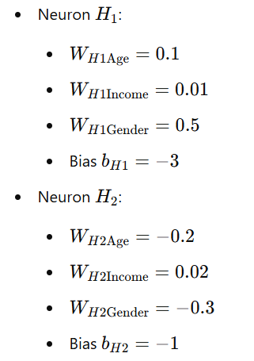
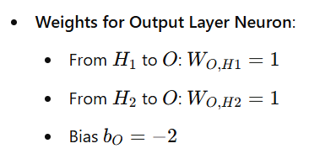
Steps in Decompositional Approach
1. Train a Neural Network and Prune Connections:
Let’s train a small neural network with:
Input Layer: 3 inputs (Age, Income, Gender encoded as 0 for Male and 1 for Female)
Hidden Layer: 2 neurons
Output Layer: 1 output neuron (Binary classification)
Assumed Weights and Biases:
Weights for Hidden Layer Neurons:

Slide 84
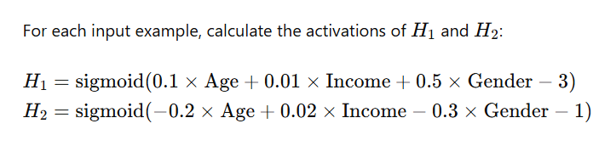
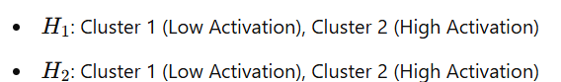
2. Categorize Hidden Unit Activation Values Using Clustering:
Hidden Layer Activation Calculation:
Perform clustering on the hidden unit activations to categorize them. For simplicity, let’s say we use k-means clustering to find 2 clusters for each hidden neuron.
Example Clustering Results:

Slide 85
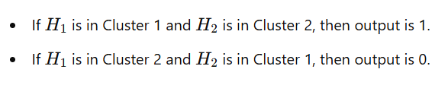
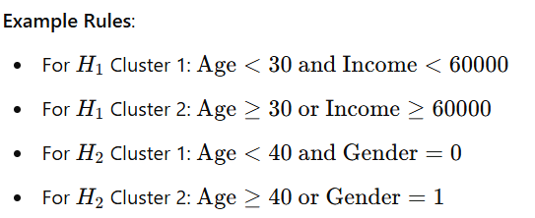
3. Extract Rules from Hidden Unit Activations to Network Outputs:
Determine the relationship between hidden unit activations and the output using rules:
Example Rules:
4. Extract Rules from Inputs to Categorized Hidden Unit Activations:
Determine the relationship between inputs and the categories of hidden unit activations:

Slide 86
5. Merge the Rules to Relate Inputs Directly to Outputs:
Combine the rules from steps 3 and 4 to directly relate the inputs to the outputs:
Example Combined Rules:
Rule 1 : If Age<30 and Income<60000 and Age >=40 or Gender=1 then output is 1.
Rule 2 : If Age>=30 or Income>=60000 and Age<40 and Gender=0 then output is 0.

Slide 87
When using either Decompositional or pedagogical rule extraction approaches, the rule sets should be evaluated in terms of their accuracy, conciseness (e.g., number of rules, number of conditions per rule), and fidelity.
Accuracy: How well do the extracted rules predict the outcomes compared to the original neural network?
Conciseness: This refers to how compact and understandable the rule set is. Fewer rules and conditions per rule make the model easier to interpret.
Fidelity: The accuracy or closeness of the model's predictions to the actual values or desired outcomes. This measures how closely the extracted rule set mimics the neural network’s predictions. It's a key metric for assessing how well the simpler model captures the behavior of the complex neural network.

Slide 88
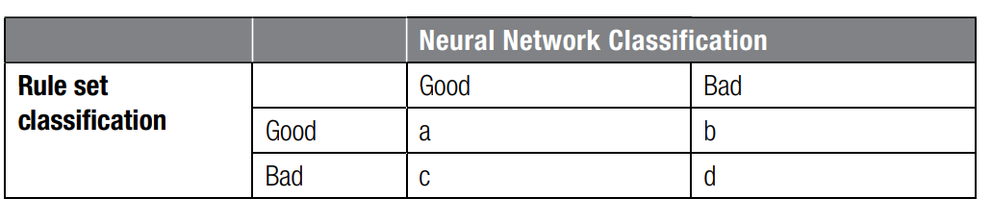
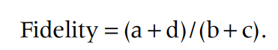
Fidelity is calculated using a confusion matrix, which summarizes the performance of a classification model.
 |  | PREDICTED
ACTUAL |  | True | False
 | True | TP | FN
 | False | FP | TN

Slide 89
Two‐stage model setup
The two-stage model setup you described is a hybrid approach that aims to balance interpretability with performance in machine learning.
In this approach, you use two different models sequentially:
First Stage - Interpretable Model: Start with a simple, interpretable model such as linear regression or logistic regression. These models are easy to understand and interpret because their predictions are based on straightforward mathematical relationships.
Second Stage - Neural Network: Use a neural network to predict the residual errors (or errors) from the first model. This stage captures complex patterns and interactions that the simple model might miss, improving overall predictive performance.

Slide 90
How It Works
Train the Interpretable Model:Train a linear regression or logistic regression model on your data. This model provides predictions and a clear understanding of how each feature contributes to the target variable. For example, in a linear regression model, you can see the coefficient of each feature, which directly shows its influence on the target.
Calculate Residuals:Compute the residuals, which are the differences between the actual values and the predictions made by the interpretable model.
Train the Neural Network: Use the residuals from the first model as the target variable to train the neural network. The neural network learns to predict these residuals using the same features.
Combine Both Models:Combine the predictions of the linear model and the neural network to get the final prediction. For regression, the final prediction might be:
For classification, the final prediction might be:

Slide 91

Two stage Models Illustration - Procedure
Step 1: Start from original data.
Step 2: Build logistic regression model.
Step 3: Calculate errors from logistic regression model.
Step 4: Build NN predicting errors from logistic regression model.
Step 5: Score new observations by adding up logistic regression and NN scores.

Slide 92
Two stage Models Illustration
Step 1: Original Data
Step 2: Logistic Regression Model

Slide 93





Slide 94


Slide 95


Step 3: Calculate Errors

Slide 96

Step 4: Neural Network Model
Use the logistic regression output along with the original features as input to the neural network. The neural network will further refine the prediction.

Slide 97






Slide 98

Step 5: Final Prediction

Slide 99

Two key shortcomings of neural networks
1. Function is non convex(may have multiple local minima)
2. Tune the number of hidden neurons.
Support Vector Machines will solve these outcomes.
It is a supervised machine learning algorithm that classifies data by finding an optimal line or hyperplane that maximizes the distance between each class in an N-dimensional space.
The objective is to classify instances (e.g., customers) into two categories (e.g., good and bad) by minimizing the sum of error variables.

Slide 100


The classification task involves two sets of constraints, one for good customers and one for bad customers.
The constraints aim to assign scores based on a linear combination of features, using weights w1,w2,w3………….wn.
For Good Customers (1 ≤ i ≤ ng​)
For each good customer, the score should be above a certain cut-off value c, minus an error term ei:
For Bad Customers (ng+1 ≤ I ≤ ng+nb​)
For each bad customer, the score should be below the cut-off value c, plus an error term ei:
The error terms ei are non-negative:
ei≥0

Slide 101

SVM Classifier for the Perfectly Linearly Separable Case

Slide 102

The problem is classified as a Quadratic Programming (QP) problem because the objective function is quadratic in terms of 𝑤, and the constraints are linear. This type of problem is convex.
The cost function is convex, which implies that there is only one global minimum and no local minima which makes it easier to find the optimal solution using optimization techniques.
Lagrangian optimization techniques: This involves introducing Lagrange multipliers to handle the constraints and then solving the resulting Lagrangian dual problem. This method is often used for solving SVM problems.

Slide 103
Support Vectors
Support vectors are the training points that lie closest to the decision boundary (the hyperplanes H1 and H2​):
Support Vectors: These are the data points that are on the boundary of the margin and are essential for defining the optimal hyperplane. The decision boundary is influenced directly by these points.
Classification Hyperplane (H0): The hyperplane that separates the two classes. For a new observation, the classification is determined by checking which side of this hyperplane the observation lies on.

Slide 104

Classification
To classify new observations, you use the decision function:
where:
wTx+b is the value of the decision function for a new observation x.
sign(.) returns +1 if the value is positive and -1 if the value is negative.
The problem is about finding the optimal weight vector w and bias b to define the hyperplane that best separates the classes while maximizing the margin between them.
Support vectors are critical for determining this hyperplane, and new data points are classified based on their position relative to this hyperplane.

Slide 105

The SVM classifier discussed so far assumed perfect separation.
In case of overlapping class distributions the SVM classifier can be extended with error terms as follows:

Slide 106


SVM Classifier in Case of Overlapping Distributions

Slide 107

The error variables $e_{k}$ are needed to allow for misclassifications.
The C hyperparameter in the objective function balances the importance of maximizing the margin versus minimizing the error on the data.
A high (low) value of C implies a higher (lower) risk of overfitting.
Again a quadratic programming (QP) problem is obtained that can be solved using Lagrangian optimization.
Finally, the nonlinear SVM classifier will first map the input data to a higher dimensional feature space using some mapping ϕ(x).

Slide 108


Slide 109

Feature Space Mapping
Mapping data points from an input space to a higher-dimensional feature space using a function ϕ(x).
In this higher-dimensional space, a linear separator (such as a hyperplane) can more easily distinguish between different classes of data points.
This concept is fundamental in support vector machines (SVMs) and kernel methods.

Slide 110

Imagine a dataset where each customer is characterized by their income and debt, and each customer is labeled as "good" or "bad" based on their creditworthiness.

Slide 111
Input Space
In the input space, we plot these customers based on their income and debt. The "Good" customers are marked with 'X', and the "Bad" customers are marked with 'O'.
Feature Space Mapping
Using a kernel function K(x1,x2)=ϕ(x1)T ϕ(x2) we map the input space into a higher-dimensional feature space.
The kernel function allows us to compute the dot product of the transformed features without explicitly calculating ϕ(x).
This transformation can make the data linearly separable in the new feature space.

Slide 112
In the feature space, we find a hyperplane that separates the good and bad customers.
This hyperplane is defined by wTϕ(xi)+, where w is a weight vector, ϕ(xi)is the mapped feature vector, and b is a bias term.
By using a kernel function, we can handle non-linear relationships in the data and find an optimal separating hyperplane in the feature space.
This technique is powerful for classification tasks where the input space does not allow a simple linear separation.

Slide 113


The nonlinear SVM classifier then becomes:
$∝_{k}$are the Lagrangian multipliers stemming from the optimization.
Support vectors will have nonzero $∝_{k}$ since they are needed to construct the classification line.
All other observations have zero $∝_{k}$, which is often referred to as the sparseness property of SVMs.

Slide 114

Different types of kernel functions can be used. The most popular are:

Slide 115

An SVM classifier can be very easily represented as a neural network
The hidden layer uses, for example, RBF activation functions, whereas the output layer uses a linear activation function.
Note that the number of hidden neurons now corresponds to the number of support vectors and follows automatically from the optimization.
This is in strong contrast to neural networks where the number of hidden neurons needs to be tuned manually.

Slide 116
The process of tuning hyperparameters for a Support Vector Machine (SVM) with a Radial Basis Function (RBF) kernel.
Hyperparameter tuning is crucial to optimizing the performance of an SVM classifier.
A hyperparameter is a parameter whose value is set before the learning process begins and governs the training and structure of a machine learning model. Example :Number of Trees, Number of Hidden Layers and Units, Kernel Type.
Problem setup:
You have an RBF SVM model, which has two key hyperparameters:
C: Regularization parameter.
σ (sigma): Parameter of the RBF kernel, often related to the width of the Gaussian kernel.

Slide 117
Hyperparameter Tuning Procedure
1. Data Partitioning :
Divide your dataset into three parts:
Training Data (40%): Used to train the model.
Validation Data (30%): Used to validate the model and select the best hyperparameters.
Test Data (30%): Used to evaluate the performance of the final model.

Slide 118
2. Hyperparameter Grid Search :
Choose a range of values for each hyperparameter and evaluate the performance of the SVM for each combination. For this example:
σ values: {0.5, 5, 10, 15, 20,25, 50, 100, 250, 500}
C values: {0.01, 0.05, 0.1, 0.5, 1, 5, 10, 50, 100, 500}
You’ll train an SVM model for each possible combination of σ and C. For instance:
(σ=0.5, C=0.01)
(σ=0.5, C=0.05)
(σ=5, C=0.1)
… and so on for all combinations.

Slide 119
3. Evaluate on Validation Data
For each combination, evaluate the performance of the SVM classifier on the validation set.
Metrics might include accuracy, precision, recall, F1-score, or others, depending on the problem.
Suppose the combination (σ=15, C=1) performs the best on the validation set in terms of accuracy.
4. Retrain with Optimal Hyperparameters
Using the best (σ, C) combination from the validation phase (e.g., σ=15, C=1), retrain the SVM classifier using the combined training and validation data.
This step ensures that the model benefits from as much data as possible before final evaluation.

Slide 120
5. Test the Model
Evaluate the final model’s performance on the test set.
This final performance metric provides an estimate of how well the model is likely to perform on unseen data.

Slide 121
Example(Recap)
Partition Data: Split your data into training (40%), validation (30%), and test (30%) sets.
Grid Search:
Train SVM with combinations like (σ=0.5, C=0.01), (σ=0.5, C=0.05), etc., using only the training data.
Validate each model with the validation set to find which combination performs best.
Best Combination: Suppose (σ=15, C=1) has the highest accuracy on the validation set.
Retrain: Retrain the SVM classifier using the combined training and validation data with (σ=15, C=1).
Test: Evaluate the final model with (σ=15, C=1) on the test set to see how well it performs.

Slide 122


SVMs can also be used for regression applications(Support Vector Regression (SVR))
Function f(x) aims to predict the target y for a given input x.
$∈−tube:This$represents the region where predictions are considered to be acceptable. Any prediction within $∈$ distance from the target value yi is not penalised. Which means errors that are greater than $∈$ are penalised.
The training set consists of n data points{$x_{k,}$ $y_{k,}).$
The goal is to fit the function to these data points such that predictions are within the $∈−tube$ as much as possible.

Slide 123



Slide 124
Regression Algorithm | Classification Algorithm
In Regression, the output variable must be of continuous nature or real value. | In Classification, the output variable must be a discrete value.
The task of the regression algorithm is to map the input value (x) with the continuous output variable(y). | The task of the classification algorithm is to map the input value(x) with the discrete output variable(y).
Regression Algorithms are used with continuous data. | Classification Algorithms are used with discrete data.
In Regression, we try to find the best fit line, which can predict the output more accurately. | In Classification, we try to find the decision boundary, which can divide the dataset into different classes.
Regression algorithms can be used to solve the regression problems such as Weather Prediction, House price prediction, etc. | Classification Algorithms can be used to solve classification problems such as Identification of spam emails, Speech Recognition, Identification of cancer cells, etc.
The regression Algorithm can be further divided into Linear and Non-linear Regression. | The Classification algorithms can be divided into Binary Classifier and Multi-class Classifier.

Slide 125
Ensemble Method
Ensemble methods are techniques in machine learning that combine multiple models to improve overall performance compared to using just one model.
Different models might be good at capturing different patterns in the data. By combining them, the strengths of one model can compensate for the weaknesses of another, leading to more robust and accurate predictions.
Some models, like decision trees, are highly sensitive to variations in the training data. Small changes in the data can lead to different models being built. By using multiple models, ensemble methods reduce the impact of this sensitivity. Since different models might respond differently to data variations, combining them helps to smooth out these fluctuations and improve performance.

Slide 126
Types of Ensemble Methods
Bagging (Bootstrap Aggregating): This technique involves creating multiple models by training each one on a different subset of the training data (created by sampling with replacement). The final prediction is typically the average (for regression) or majority vote (for classification) of all the models.
Boosting: This method builds models sequentially, where each new model focuses on correcting the errors made by the previous models. The final prediction is a weighted combination of all models, with more emphasis on those that correct previous errors.
Random Forests: This is an ensemble of decision trees created using bagging. Each tree is trained on a random subset of the data and features, which introduces diversity among the trees and helps improve the overall model's accuracy.

Slide 127
Bagging
Bagging, short for Bootstrap Aggregating, is a technique used to improve the accuracy and stability of machine learning models.
Bootstrap Sampling : creating multiple new datasets from the original dataset
Training Models:For each bootstrap dataset, a separate model is trained.
Making Predictions
For Classification : Majority Vote
For Regression : Average
Evaluating and Tuning :Standard Error and confidence interval
Why Bagging Works :Unstable data

Slide 128
Boosting
Boosting is a machine learning ensemble technique designed to improve the accuracy of models by combining multiple weak models into a stronger one. The fundamental idea behind boosting is to sequentially train models that focus on the mistakes made by previous models, with the goal of improving overall performance.
Weighted Data : In boosting, each observation in the training data is assigned a weight.
Iterative Process :Boosting works through multiple iterations or boosting rounds.
Focus on Misclassified Cases:Observations that are misclassified by the current model are given higher weights in the next iteration. This means the model will focus more on the examples it previously got wrong.
Final Model : The final model is a weighted combination of all the individual models trained during the boosting process.
Example :AdaBoost Algorithm Steps

Slide 129
Advantages and Drawbacks
Advantages:
Improved Accuracy: Boosting can significantly improve model accuracy by focusing on hard-to-classify examples.
Flexibility: It can be applied to various types of models and problems.
Drawbacks:
Overfitting Risk: If not controlled, boosting can overfit the training data, especially if the base models are too complex or if there is a lot of noise in the data.
Computational Cost: Boosting can be computationally expensive, as it involves training multiple models sequentially.

Slide 130
Random forests
Random Forests is a powerful ensemble learning technique developed by Leo Breiman.
It builds on the idea of creating a "forest" of decision trees to improve predictive accuracy and robustness.

Slide 131
How Random Forests Work
Initialization:Given a dataset with n observations and N input features, the goal is to build a collection of decision trees to make predictions.
Bootstrap Sampling :Sampling n observations from the original dataset with replacement.
Building Each Tree : Build a decision tree whereby for each node of the tree, randomly choose m inputs on which to base the splitting decision. Split on the best of this subset. Fully grow each tree without pruning.
Making Predictions:The final prediction is determined by majority voting among the trees.The prediction is the average of the predictions from all the trees in the forest.

Slide 132
Key Features of Random Forests
Diversity Among Trees: The diversity of the trees is crucial for the effectiveness of Random Forests. This diversity is achieved through:
Bootstrap Sampling: Different trees are trained on different subsets of the data.
Random Feature Selection: Each tree makes splitting decisions based on a random subset of features, reducing the correlation between trees.
Robustness and Accuracy: By averaging or voting across many trees, Random Forests typically provide better predictive performance and are less prone to overfitting compared to individual decision trees.

Slide 133
Comparison with Other Techniques
Rotation Forests:
A variant of Random Forests, Rotation Forests apply Principal Component Analysis (PCA) to the data before building the trees.
Feature Rotation: Transforming the feature space using PCA to create new, uncorrelated features.
Building Trees: Training decision trees on these transformed features. This rotation can improve the accuracy of base classifiers but may reduce the ability to rank individual feature importance.

Slide 134
MULTICLASS CLASSIFICATION TECHNIQUES
All of the techniques previously discussed can be easily extended to a multiclass setting, whereby more than two target classes are available.

Slide 135
Multiclass Logistic Regression
When dealing with multiclass classification problems, logistic regression can be extended to handle more than two classes. The approach varies slightly depending on whether the target variable is nominal or ordinal.

Slide 136



Nominal Multiclass Logistic Regression
In nominal logistic regression, the target variable consists of categories that do not have a natural order. Examples include predicting types of blood (A, B, AB, O) or voting behavior (Democrat, Republican, Independent).
Model Specification:
Choosing a Base Class: Choose one of the K class as reference where all other classes are compared against this base class.
Model Formulation: For remaining K-1 classes, calculate the likelihood of occurring one class relative to a base class.
Probability Calculation:
Parameter Estimation: Parameter $β$ are estimated using Maximum Likelihood Estimation(MLE).

Slide 137

Ordinal Multiclass Logistic Regression
In ordinal logistic regression, the target variable has a natural order or ranking but not necessarily a fixed interval. Examples include credit ratings (Poor, Fair, Good, Excellent) or income brackets (Low, Medium, High).
Cumulative Logistic Regression:
Model Specification :Cumulative Probability Model is used.
Probability Calculation:
Parameter Estimation: Parameter $β$ are estimated using Maximum Likelihood Estimation(MLE).

Slide 138

Multiclass Decision Trees
Decision trees can be easily extended to a multiclass setting.
For the splitting decision, assuming K classes, the impurity criteria become:
The stopping decision can be made in a similar way as for binary target decision trees by using an independent validation data set.
The assignment decision then looks for the most prevalent class in each of the leaf nodes.

Slide 139
Multiclass Neural Networks
To create K output neurons, one for each class.
An observation is then assigned to the output neuron with the highest activation value

Slide 140


Multiclass Support Vector Machines
For K classes, one‐versus‐one coding estimates K(K − 1)/2 binary SVM classifiers contrasting every possible pair of classes. Every classifier as such can cast a vote on the target class and the final classification is then the result of a (weighted) voting procedure. Ties are resolved arbitrarily.
For K classes, one‐versus‐all coding estimates K binary SVM classifiers each time contrasting one particular class against all the other ones. A classification decision can then be made by assigning a particular observation to the class for which one of the binary classifiers assigns the highest posterior probability.
One‐versus‐All Coding for Multiclass Problems
One‐versus‐One Coding for Multiclass Problems

Slide 141
EVALUATING PREDICTIVE MODELS

Slide 142

ASSOCIATION RULES

Slide 143

An association rule is then an implication of the form X ⇒ Y, whereby X ⊂ I, Y ⊂ I and X ∩ Y = ∅. X is referred to as the rule antecedent, whereas Y is referred to as the rule consequent.

Slide 144


Slide 145

Support and Confidence
Support and confidence are two key measures to quantify the strength of an association rule. The support of an item set is defined as the percentage of total transactions in the database that contains the item set. Hence, the rule X ⇒ Y has support (s) if 100s% of the transactions in D contain X ∪ Y. It can be formally defined as follows:
Example : the association rule baby food and diapers ⇒ beer has support 3/10 or 30 percent.

Slide 146

The confidence measures the strength of the association and is defined as the conditional probability of the rule consequent, given the rule antecedent. The rule X ⇒ Y has confidence (c) if 100c% of the transactions in D that contain X also contain Y. It can be formally defined as follows:
Example : the association rule baby food and diapers ⇒ beer has confidence 3/5 or 60 percent.

Slide 147
SEQUENCE RULES
Given a database D of customer transactions, the problem of mining sequential rules is to find the maximal sequences among all sequences that have certain user‐specified minimum support and confidence. An example could be a sequence of web page visits in a web analytics setting, as follows:
Home page ⇒ Electronics ⇒ Cameras and Camcorders ⇒ Digital Cameras ⇒ Shopping cart ⇒ Order confirmation⇒ Return to shopping.
Association rules are concerned about what items appear together at the same time (intra-transaction patterns), sequence rules are concerned about what items appear at different times (inter-transaction patterns).

Slide 148

A sequential version can then be obtained as follows:
Session 1: A, B, C
Session 2: B, C
Session 3: A, C, D
Session 4: A, B, D
Session 5: D, C, A
For example, the sequence rule A ⇒ C. A first approach would be to calculate the support whereby the consequent can appear in any subsequent stage of the sequence. In this case, the support becomes 2/5 (40%). Another approach would be to only consider sessions in which the consequent appears right after the antecedent. In this case, the support becomes 1/5 (20%). A similar reasoning can now be followed for the confidence, which can then be 2/4 (50%) or 1/4 (25%), respectively.

Slide 149
SEGMENTATION
The aim of segmentation is to split up a set of customer observations into segments such that the homogeneity within a segment is maximized (cohesive) and the heterogeneity between segments is maximized (separated).
Applications :
Understanding a customer population (e.g., targeted marketing or advertising [mass customization])
■ Efficiently allocating marketing resources
■ Differentiating between brands in a portfolio
■ Identifying the most profitable customers
■ Identifying shopping patterns
■ Identifying the need for new products

Slide 150


Slide 151

Hierarchical Clustering
Divisive hierarchical clustering starts from the whole data set in one cluster, and then breaks this up in each time smaller clusters until one observation per cluster remains. Agglomerative clustering works the other way around, starting from all observations in one cluster and continuing to merge the ones that are most similar until all observations make up one big cluster.

Slide 152


In order to decide on the merger or splitting, a similarity rule is needed.
1. Euclidean distance
2. Manhattan (city block) distance.

Slide 153
K‐Means Clustering
K‐means clustering is a nonhierarchical procedure that works along the following steps:
1. Select k observations as initial cluster centroids (seeds).
2. Assign each observation to the cluster that has the closest centroid (for example, in Euclidean sense).
3. When all observations have been assigned, recalculate the positions of the k centroids.
4. Repeat until the cluster centroids no longer change.

Slide 154

A self‐organizing map (SOM) is an unsupervised learning algorithm that allows you to visualize and cluster high‐dimensional data on a low‐dimensional grid of neurons.
An SOM is a feedforward neural network with two layers.
The neurons from the output layer are usually ordered in a two‐dimensional rectangular or hexagonal grid.
For the former, every neuron has at most eight neighbors, whereas for the latter every neuron has at most six neighbors.

